Slide 1


Cardiac ARrest survivors
DIGITAL SUPPORT
CARDIS-studien
The CARDIS (Cardiac ARrest survivors DIgital Support) study
Effects of a digital support program for cardiac arrest survivors
A randomized controlled trial with process evaluation
The CARDIS study

Slide 2
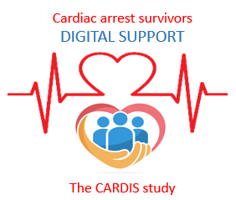
Background
Cardiac arrest can have significant cognitive, physical, psychological, and social consequences.
Many survivors experience long-term difficulties in everyday life and reduced quality of life.
Anxiety, depression, sleep problems, and post-traumatic stress disorder are common, affecting up to one in four survivors.
Cognitive impairment and severe fatigue are also common.
Structured, comprehensive rehabilitation is essential to improve quality of life and support return to work.
Identifying the long-term needs of survivors and their family members can help improve and tailor care and rehabilitation.

Slide 3
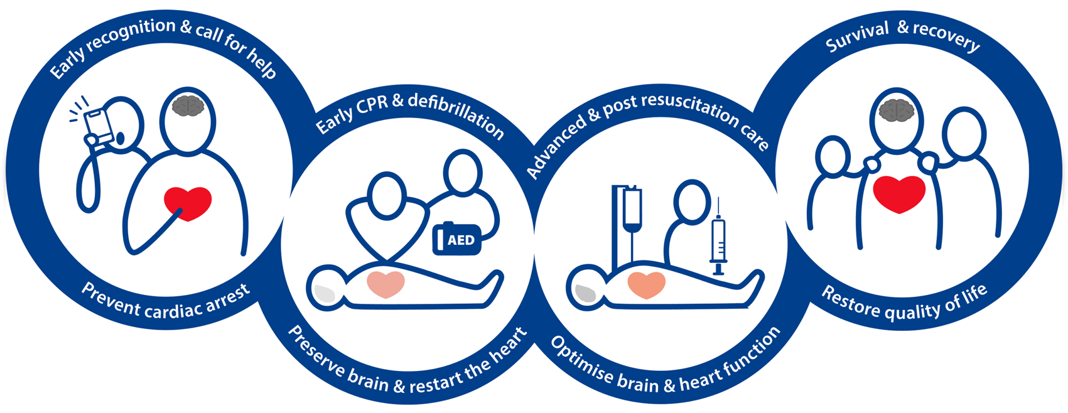
The ERC guidelines include a newly introduced final link in the
Chain of Survival, emphasizing the importance of recovery in restoring quality of life for cardiac arrest survivors and their loved ones.

Slide 4
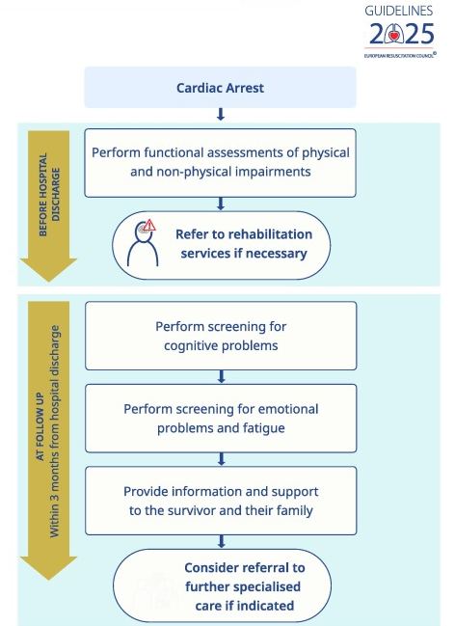
Guidelines for follow-up after cardiac arrest
Screening for:
Cognitive difficulties
Emotional problems
Fatigue
Pain
Fear of movement

Slide 5

Cardiac arrest follow-up in Sweden is uneven, with large variations between regions and hospitals, and guidelines are not always followed.
A digital support program can contribute to increased accessibility to evidence-based knowledge, as well as offer strategies for self-management of physical and emotional consequences after cardiac arrest.
Patients and co-survivors should be offered follow-up 1-3 months after cardiac arrest.
Assessment should be made of physical and emotional well-being and cognition.
Support should be offered in rehabilitation.

Slide 6
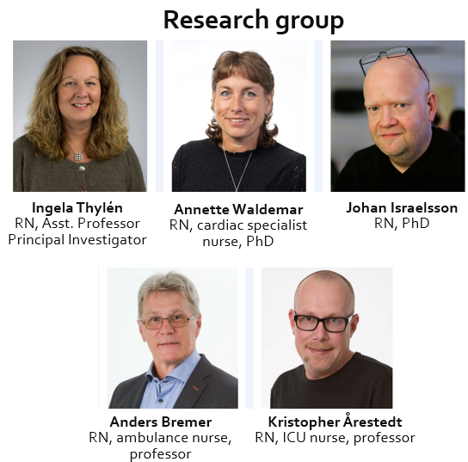
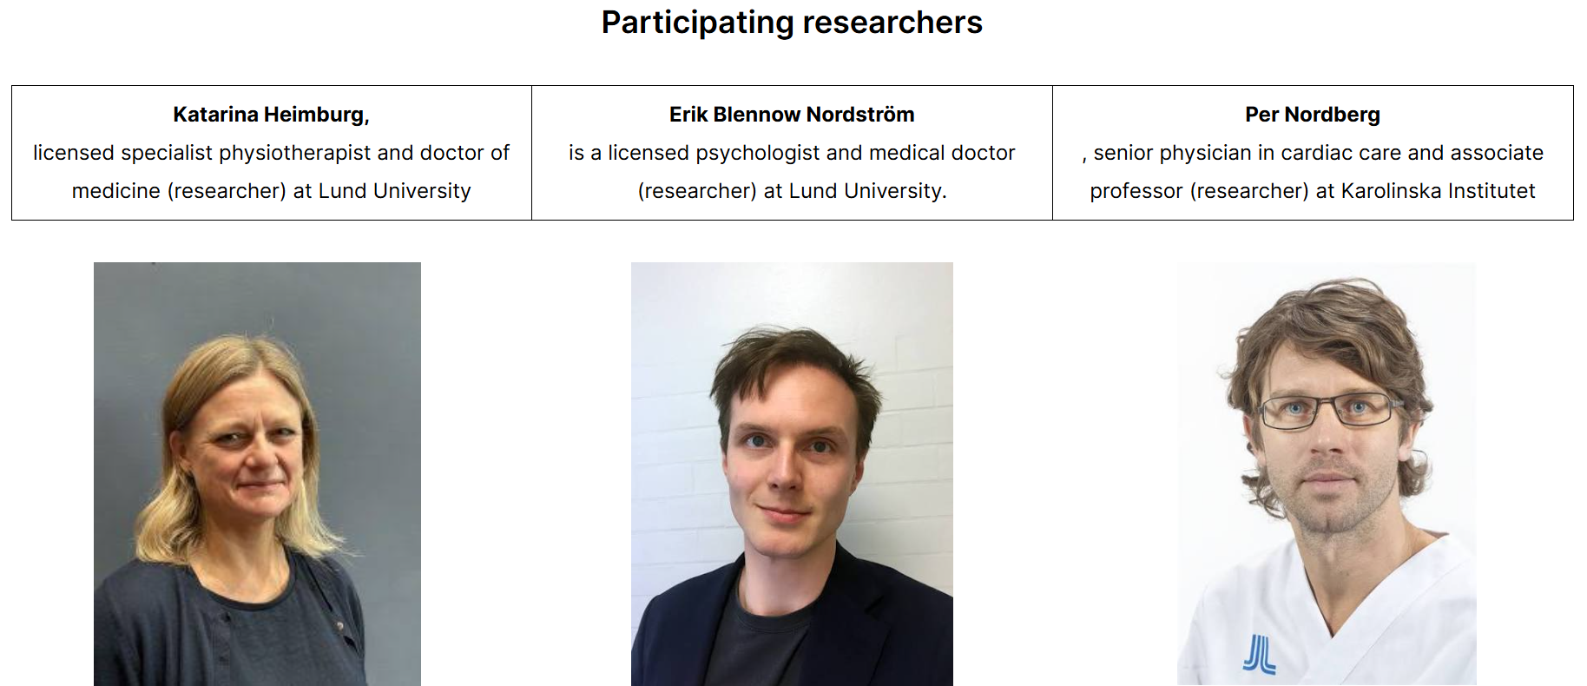
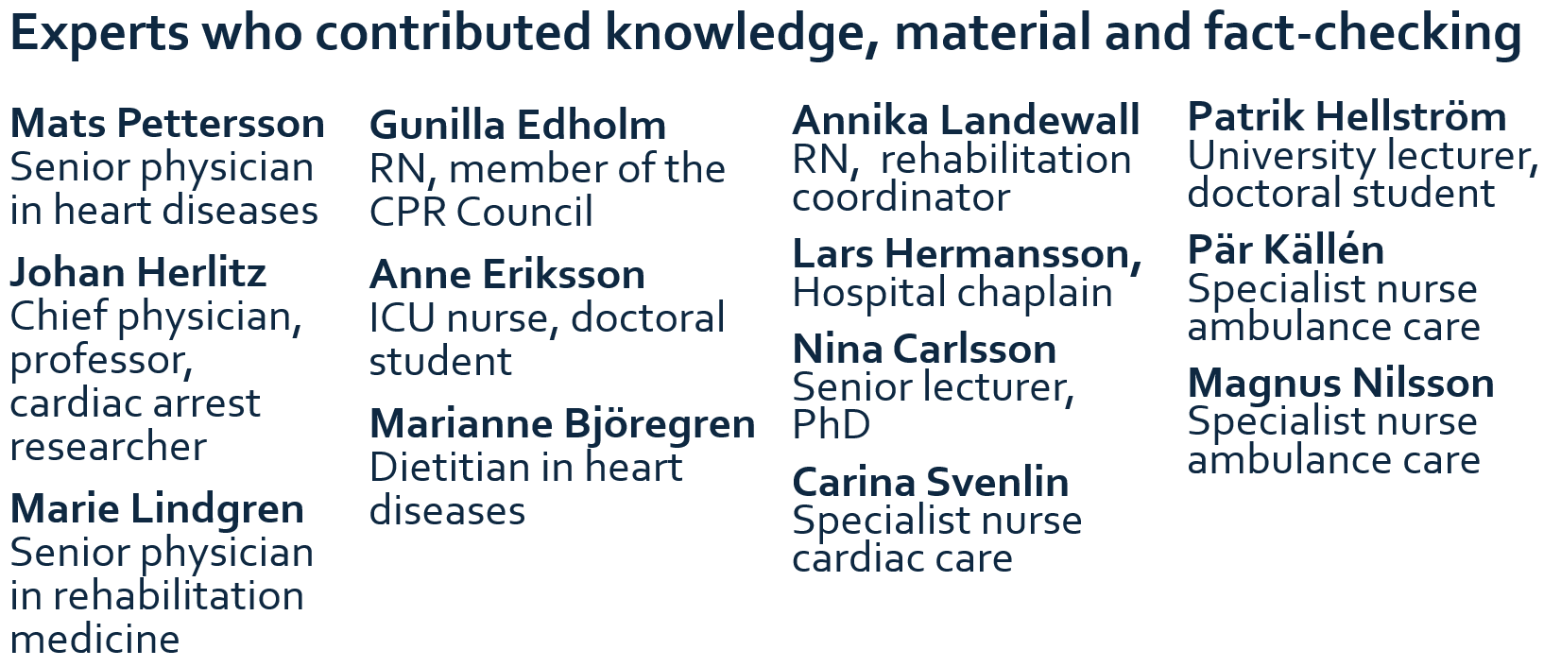
The support program was developed through co-creation with survivors, the research team, and various subject matter experts.

Slide 7
CARDIS-study
In the research project, we have developed a web-based support program as a complement to healthcare follow-up, which is currently tested in an RCT.
The support program has been developed together with cardiac arrest survivors and medical experts and includes texts, lectures, patient and family stories, films, images and links. It also includes practical exercises and support for reflecting on their own health and recovery.

Slide 8
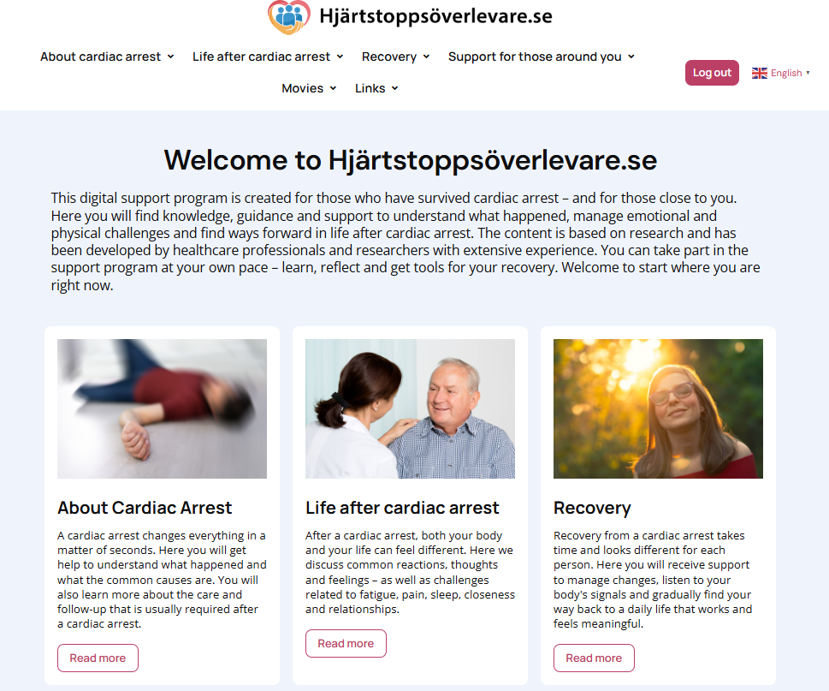
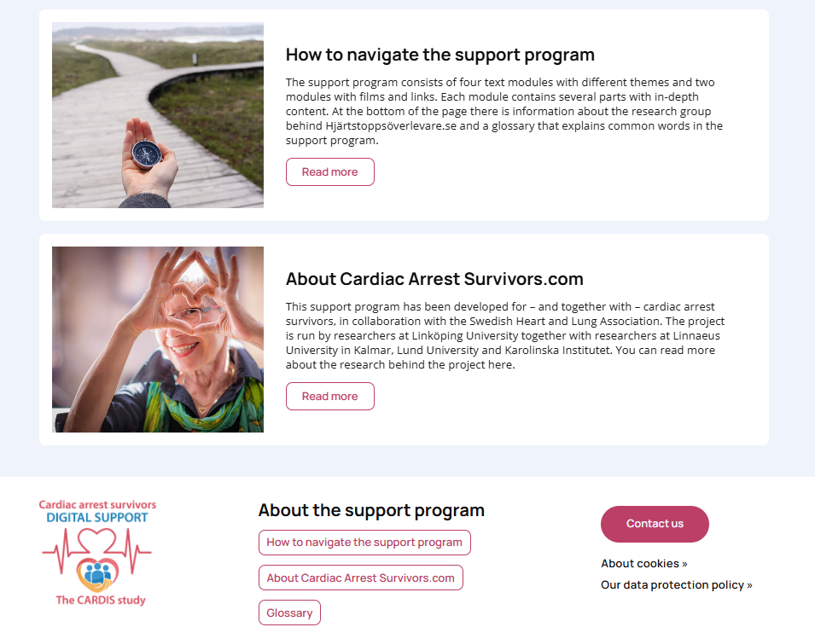
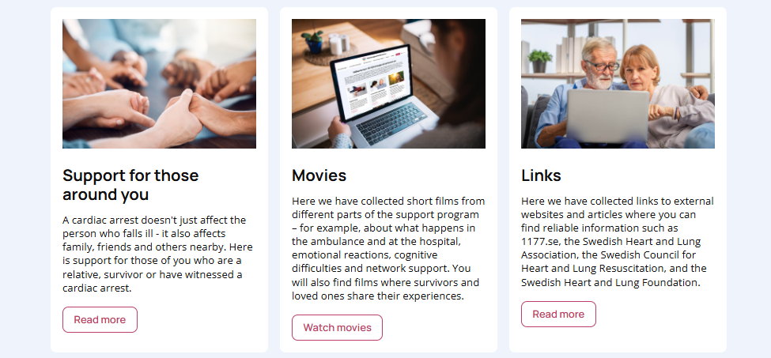
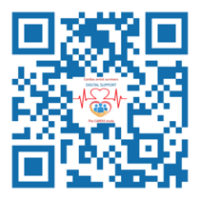
www.hjartstoppsoverlevare.se

Slide 9
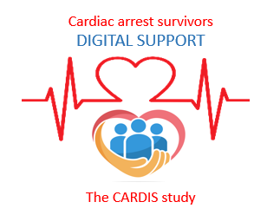
RCT
Aim
To evaluate the effect of a digital support program on general well-being, quality of life, cognition, life satisfaction, anxiety and depression, post-traumatic stress, severe fatigue, and sleep.
Primary hypothesis
Access to a digital support program, as a complement to usual care, improves general well-being compared with a control group.
Secondary hypothesis
Access to a digital support program, as a complement to usual care, improves quality of life, cognition, life satisfaction, symptoms of anxiety and depression, post-traumatic stress, fatigue, and sleep compared with a control group.

Slide 10
Inclusion and exclusion criteria
Inclusion criteria:
Participants must be ≥18 years old, have survived a cardiac arrest 1–3 months previously, and have access to a mobile phone, tablet, or computer with an internet connection.
Exclusion criteria:
Insufficient linguistic or cognitive ability to participate in a digital intervention and complete questionnaires in Swedish, as well as participation in another study involving the collection of PROM data.

Slide 11
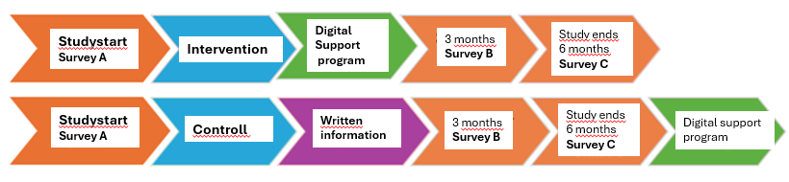
Studydesign
The patient will complete a web-based survey on health and well-being on three occasions, at baseline of the study and after 3 and 6 months.
The survey contains approximately 100 questions and is expected to take approximately 30 minutes to complete.
The patient will be randomly assigned to:
intervention group which receives access to the program for 3 months, or
control group which receives access to standard information materials and support from the healthcare services.
Those randomly assigned to the control group will be offered access to the web-based support program after 6 months.

Slide 12
What does participation in the study involve?
At the cardiac arrest follow-up, 1–3 months after the cardiac arrest, all survivors are registered in a screening log, where inclusion and exclusion criteria are documented.
If the patient meets the inclusion criteria, the patient is asked whether they are interested in participating in the study.
If the patient wishes to participate, the patient receives written information about the study.
You then contact the research team and provide the patient’s contact details.
The research team then contacts the patient and is responsible for all further follow-up. The study therefore involves no additional workload for the clinic’s nurses.

Slide 13


Please feel free to contact us.
 | Annette Waldemar PHD, Specialist Nurse, Internationell Research Coordinator Department of Health, Medicine and Care, Linköping University Department of Cardiology, Vrinnevi Hospital, Norrköping E-mail: annette.waldemar@liu.se, kontakt@hjartstoppsoverlevare.se Phone.nr: +46 76-939 95 88
 | Ingela Thylén Nurse, Assistant Professor, Principal investigator (PI) Department of Health, Medicine and Care, Linköping University Department of Cardiology, Linköping University Hospital E-mail: ingela.thylen@liu.se Phone.nr: 010-103 21 80

