Slide 1

Cardiac arrest survivors’ perspectives on a web-based support and learning platform: an interview study
Annette Waldemar
PhD, Cardiac specialist nurse
Department of Cardiology in Norrköping and Department of Health, Medicine and Caring Sciences, Linköping University, Sweden

Slide 2


Background
Survivors of cardiac arrest often face multifaceted challenges:
cognitive,
emotional,
physical problems,
existential thoughts.
Usual symptoms:
anxiety and depression,
post-traumatic stress,
fatigue and sleep disturbances
kinesiophobia.

Slide 3
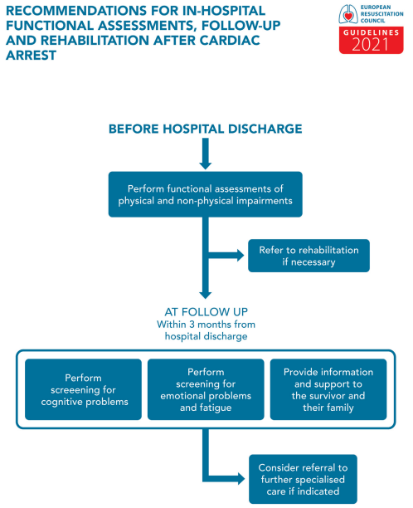
Background
International and national guidelines emphasize the importance of follow-up within three months, including patient education and psychosocial screening.
Follow-up care is often insufficient.
Survivors with non-cardiac arrest aetiology – may fall outside the scope of specialist clinics and are often left to seek support through primary care or digital platforms.
Nolan JP, Sandroni C, Böttiger BW, et al. European Resuscitation Council and European Society of Intensive Care Medicine Guidelines 2021: Post-resuscitation care. Resuscitation. 2021;161:220-269.

Slide 4



Background
Many patients turn online to find knowledge and tools for self-management.
There is limited knowledge about what survivors perceive as relevant in content, structure and delivery of digital support.
Broader initiatives to address post-cardiac arrest care are still lacking.

Slide 5

Aim
To explore survivors’ perspectives on digital support and identify relevant content and delivery formats for a web-based support and learning platform.

Slide 6
Study design
Qualitative design, combining focus group and individual interviews to gain in-depth insight into survivors’ experiences and preferences.
Procedure
The study was conducted in Sweden between November 2024 and February 2025.
Participants were recruited via the national peer support network for cardiac arrest survivors and their family members.

Slide 7

Participants
Inclusion criteria:
≥ 18 years old, Swedish-speaking and having survived a cardiac arrest.
20 participants 44 to 80 years, 8 women and 12 men.
Time since cardiac arrest: 3 months to 19 years.
All participants reported daily use of both a computer and a smartphone, and 19 used the Internet daily.

Slide 8



Data collection
Four semistructed focus group interviews (17 participants) and 3 individual interviews.
Participants were encouraged to speak freely, share experiences in their own words, and emphasise aspects they considered important.
The focus group interviews 6-113 minutes; the individual 27-44 minutes.

Slide 9
Analysis
Qualitative content analysis was used.
Three main categories and six sub-categories were identified, reflecting survivors’ needs, wishes, and preferences for a digital support program.
Main categories | Sub-categories | Codes
Need of clear communication & healthcare.. | Guided support throughout the recovery process | Ambulance care Intensive care Hospital ward care Leaving hospital and returning home Physical activity in the recovery Healthcare follow-up

Slide 10
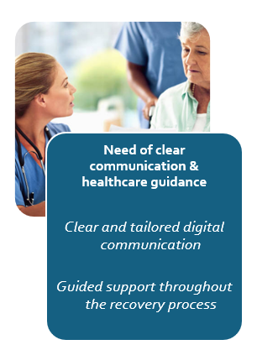
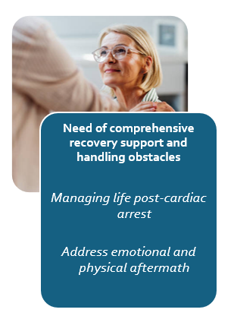
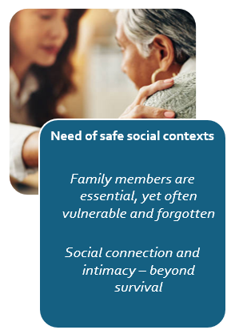
Main findings
Need of clear communication & healthcare guidance
Clear and tailored digital communication
Guided support throughout the recovery process
Need of comprehensive recovery support and handling obstacles
Managing life post-cardiac arrest
Address emotional and physical aftermath
Need of safe social contexts
Family members are essential, yet often vulnerable and forgotten
Social connection and intimacy – beyond survival

Slide 11
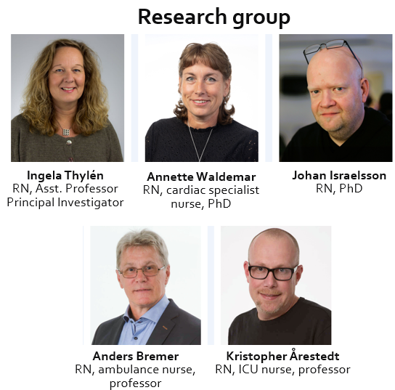
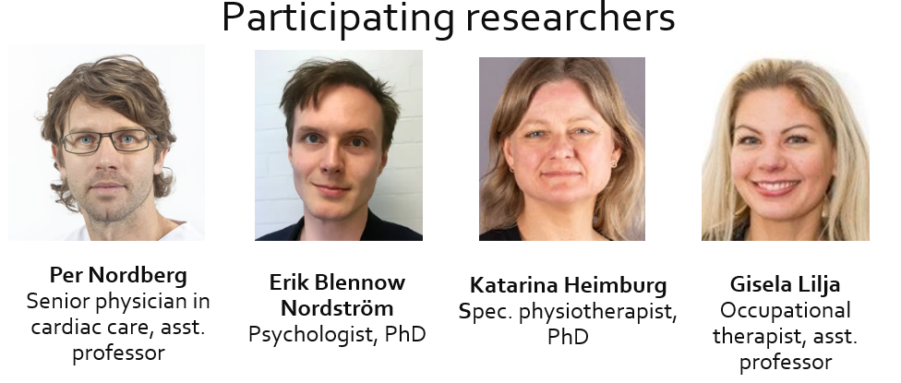
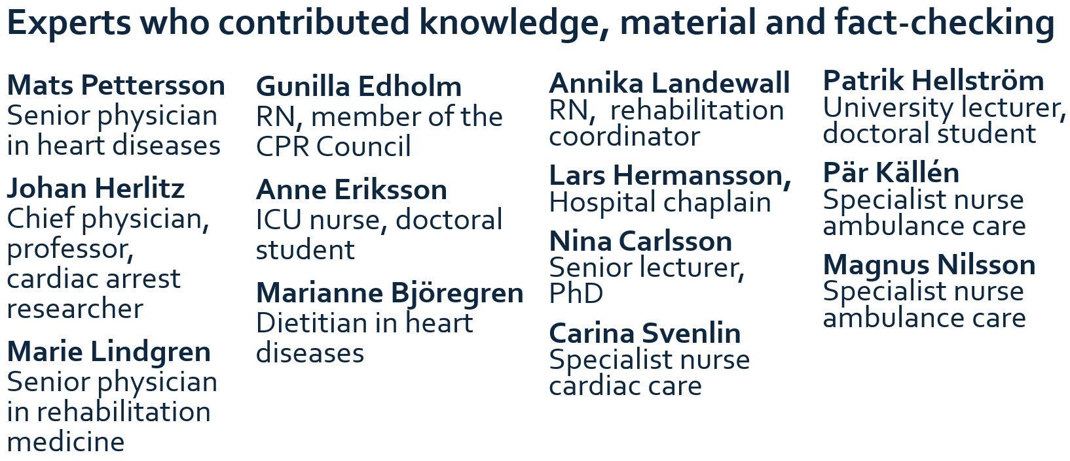
The web-based support and learning platform was developed through co-creation together with survivors, the research team, and various subject-matter experts.

Slide 12
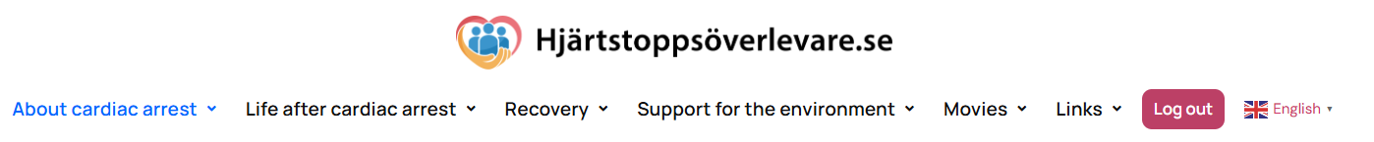
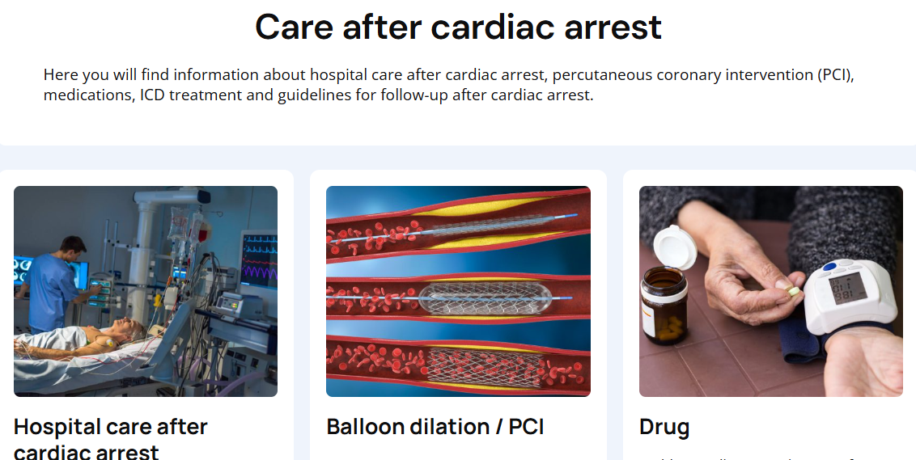
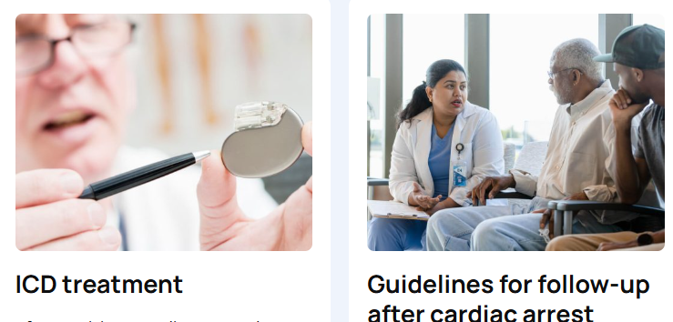
The digital support and learning platform Cardiacarrestsurvivors.se
Care after cardiac arrest
Here you will find information about hospital care after cardiac arrest, percutaneous coronary
intervention (PCI), medications, ICD treatment and guidelines for follow-up after cardiac arrest.

Slide 13
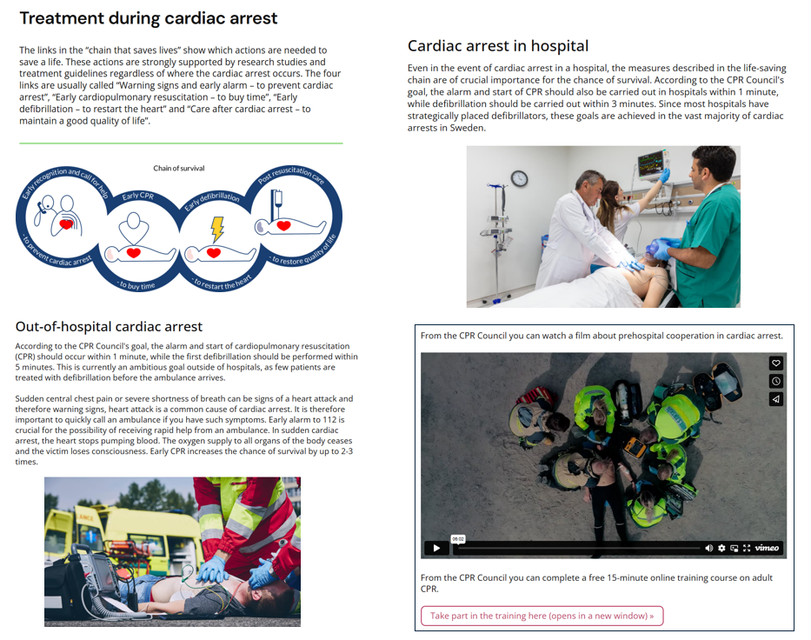

Slide 14
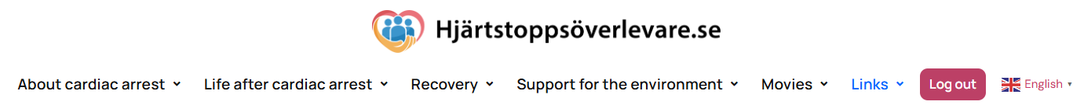
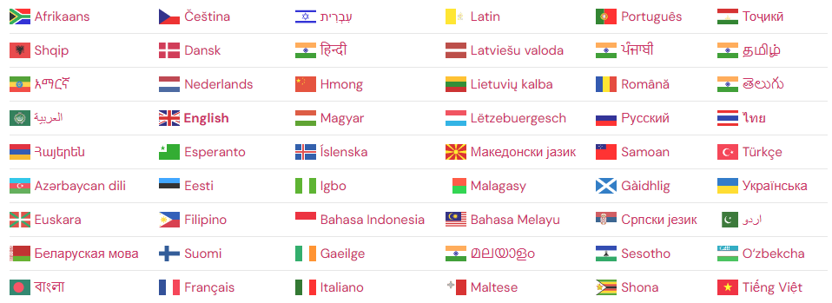
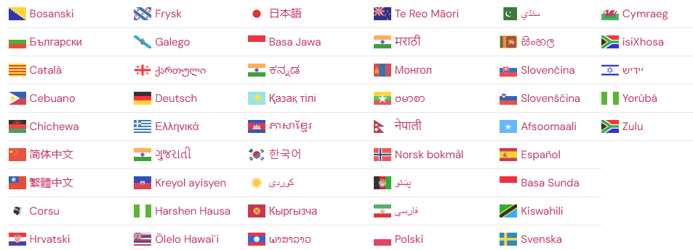
The support and learning platform can be translated into 104 languages

Slide 15
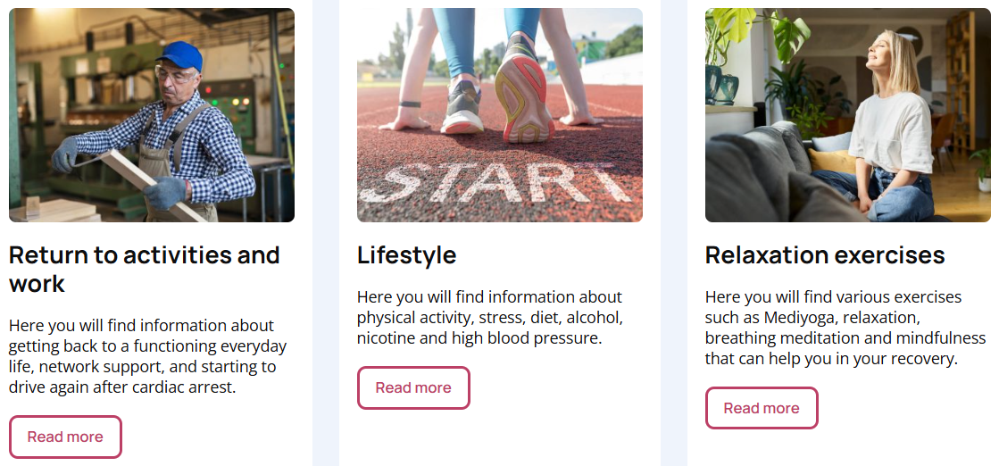
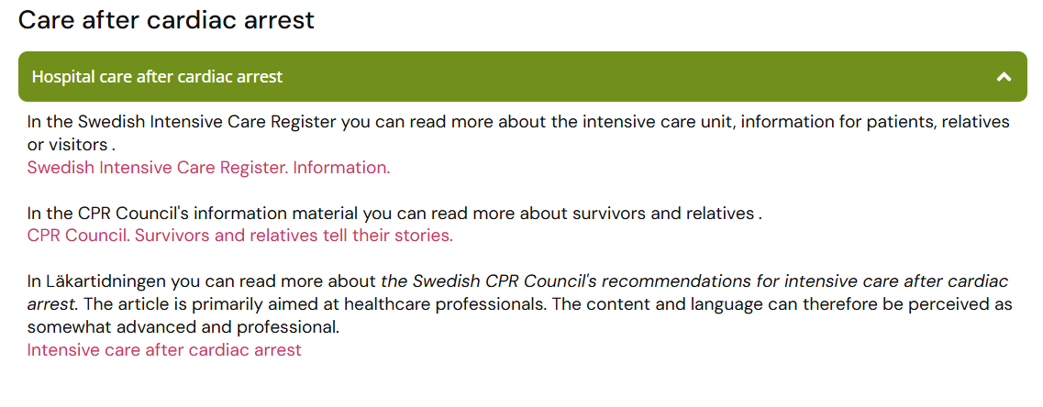
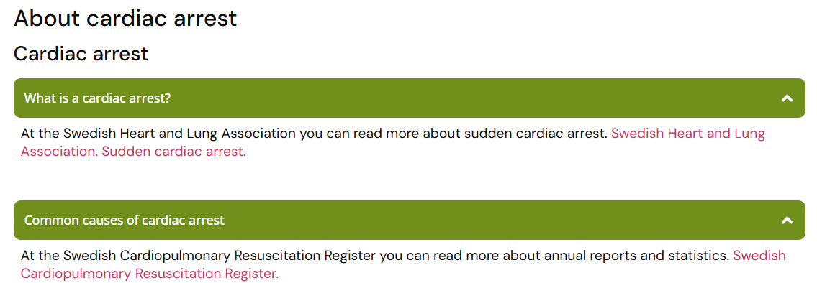
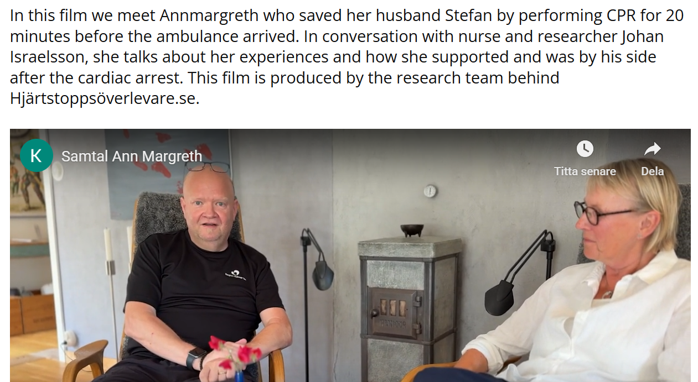
The support program covers 40 different subject areas, based on what survivors wish for
The support program includes 160 Links for those seeking more information
The support program includes 40 films

Slide 16

Contact: Annette Waldemar annette.waldemar@liu.se Department of Cardiology, Vrinnevi County hospital, SE-601 83 Norrköping, Sweden Phone: + 46 70 9690977 ORCID: A.W: 0000-0001-8591-313X.
Thanks for y0ur attention!

