Slide 1


CARDIS-studien
The CARDIS (Cardiac ARrest survivors DIgital Support) study
Effects of a digital support program for cardiac arrest survivors
A randomized controlled trial with process evaluation
Cardiac ARrest survivors
DIGITAL SUPPORT
The CARDIS study

Slide 2
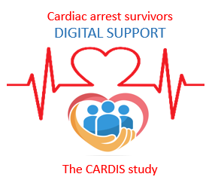
Background
Cardiac arrest can lead to significant cognitive, physical, psychological and social consequences for the affected person.
A large number of patients experience long-term impairment of their daily functioning and impaired quality of life.
In addition to physical limitations, psychological problems such as anxiety, depression, sleep problems and post-traumatic stress disorder are common and affect up to one in four survivors.
A significant proportion have some degree of cognitive impairment and many suffer from pronounced fatigue.
There is a great need for structured and versatile rehabilitation to improve quality of life and enable a return to work.
By identifying the long-term needs of both survivors and their loved ones, care and rehabilitation can be adapted and improved.

Slide 3

Cardiac arrest follow-up in Sweden is uneven, with large variations between regions and hospitals, and guidelines are not always followed.
A digital support program can contribute to increased accessibility to evidence-based knowledge, as well as offer strategies for self-management of physical and emotional consequences after cardiac arrest.
According to current guidelines, patients and co-survivord should be offered follow-up 1-3 months after cardiac arrest.
Assessment should be made of physical and emotional well-being and cognition.
Support should be offered in rehabilitation.

Slide 4
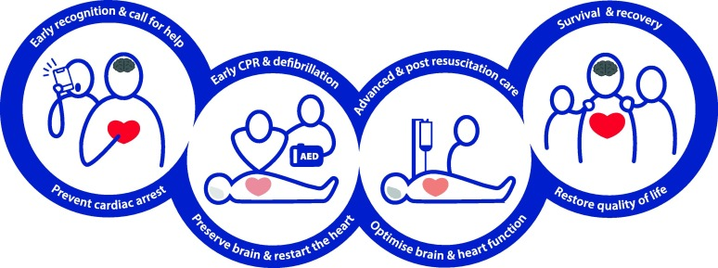
The ERC guidelines include the newly designed last ring that emphasizes the importance of recovery to restore the quality of life for survivors of cardiac arrest and their loved ones.

Slide 5
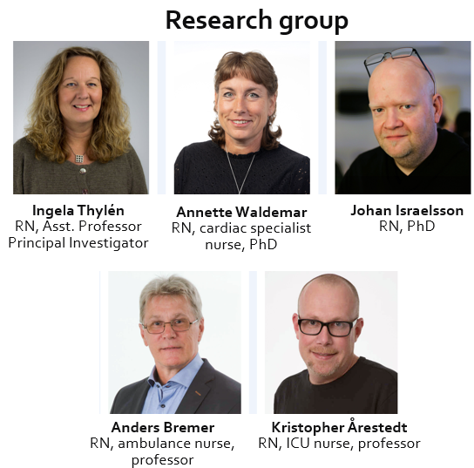
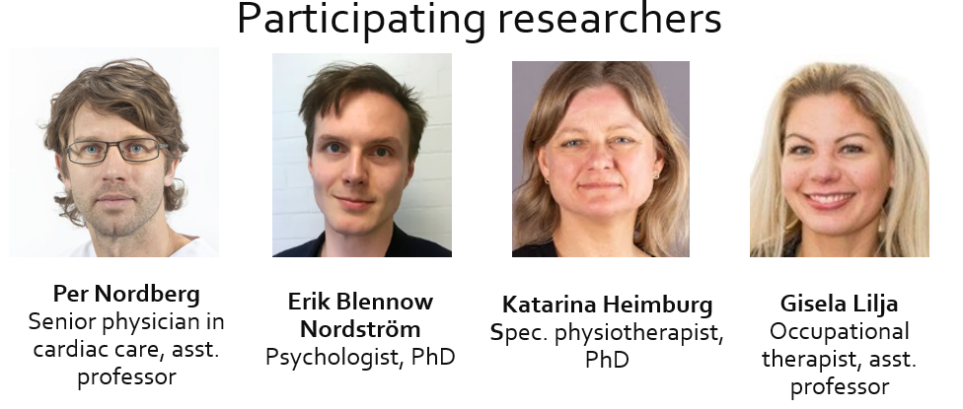
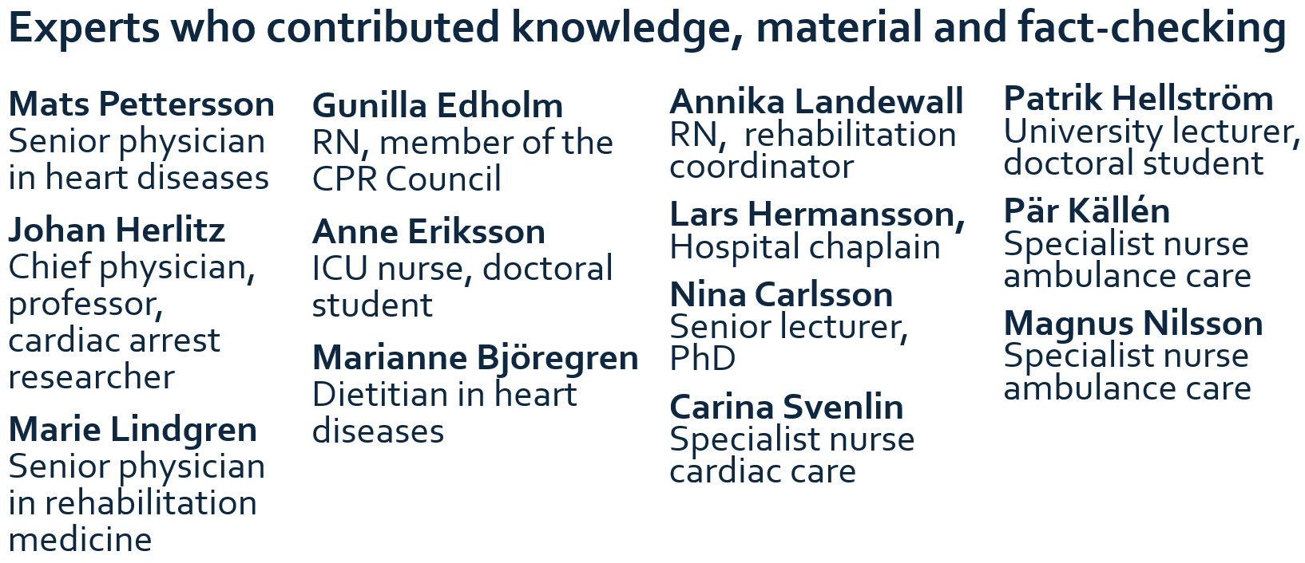
The support program has been developed through co-creation with survivors, the research team, and various subject matter experts.

Slide 6
CARDIS-study
In the research project, we have developed a web-based support program as a complement to healthcare follow-up, which is being tested in an RCT.
The support program has been designed together with cardiac arrest survivors and medical experts and includes texts, lectures, patient and family stories, films, images and links. It also includes practical exercises and support for reflecting on one's own health and recovery.
The support program also includes a chat forum led by healthcare professionals.

Slide 7
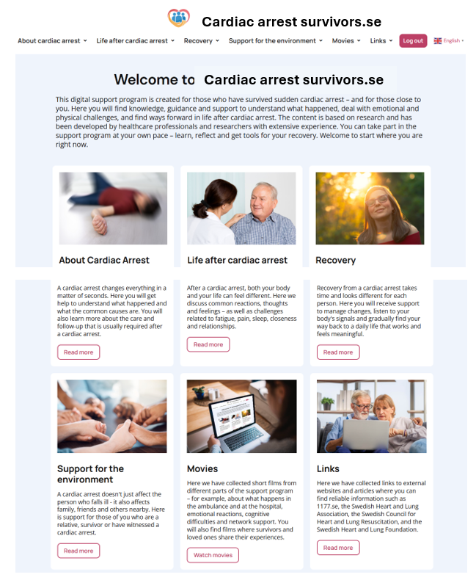
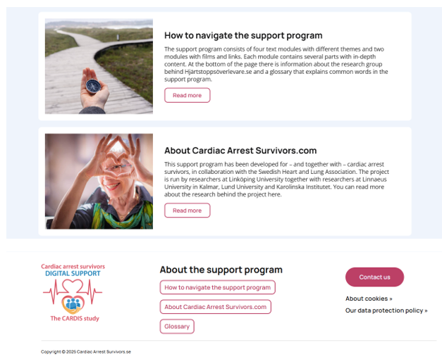
www.hjartstoppsoverlevare.se

Slide 8
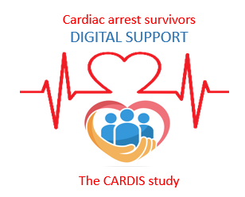
RCT
Purpose:
Evaluate the effects of the digital support program on general well-being, quality of life, cognition, life satisfaction, anxiety and depression, post-traumatic stress, pronounced fatigue and sleep.
Primary hypothesis:
Access to a digital support program – as a complement to usual care – significantly improves mental well-being compared to a control group.
Secondary hypothesis:
Access to a digital support program – as a complement to usual care – significantly improves quality of life, cognition, life satisfaction, symptoms of anxiety and depression, post-traumatic stress, fatigue and sleep compared to a control group.

Slide 9
Inclusion and exclusion criteria
Inclusion criteria:
Participants must be ≥ 18 years old, have survived a cardiac arrest 1-3 months ago, and have access to a mobile phone, tablet or computer with internet connection.
Exclusion criteria:
Lack of linguistic or cognitive ability to participate in a digital intervention and answer questionnaires designed in Swedish, as well as participation in another study that includes collection of PROM data.

Slide 10
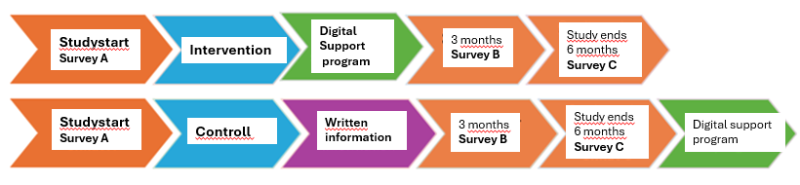
Studydesign
The patient will complete a web-based survey on health and well-being on three occasions, at the beginning of the study and after 3 & 6 months.
The survey contains approximately 100 questions and is expected to take approximately 30 minutes to complete.
The patient will be randomly assigned to:
intervention group that receives access to the program for 3 months or to a
control group that receives access to regular information materials and support from the healthcare system.
Those who are randomly assigned to the control group will also be offered access to the web-based support program after 6 months.

Slide 11
What does it mean to participate in the project?
The study team will visit all clinics that want to participate in the study and help with the start-up of cardiac arrest follow-up where there are none.
At the cardiac arrest follow-up, patients are asked at the first visit, which should be within about a month, if they are interested in participating.
When the patient has been asked about their interest, you write the patient in a logbook.
You distribute written information about the study.
Then you contact the research group and provide the patient's contact information.
Someone from the research group will then contact the patient and then do all the follow-up so that the study will not burden the clinic's nurses.

Slide 12


Please feel free to contact us.
 | Annette Waldemar PHD, Specialist Nurse, Research Coordinator Department of Health, Medicine and Care, Linköping University Department of Cardiology, Vrinnevi Hospital, Norrköping E-mail: annette.waldemar@liu.se, kontakt@hjartstoppsoverlevare.se Phone.nr: +46 76-939 95 88
 | Ingela Thylén Nurse, Assistant Professor, Principal investigater (PI) Department of Health, Medicine and Care, Linköping University Department of Cardiology, Linköping University Hospital E-mail: ingela.thylen@liu.se Phone.nr: 010-103 21 80

